Slide 1

Exploring Neuro-Symbolic
Pipelines for Structured
Knowledge Extraction
Nikolaos Laoutaris
Supervisor: Assoc. Prof. Vassilios Peristeras
MSc in Data Science – February 2026

Slide 2
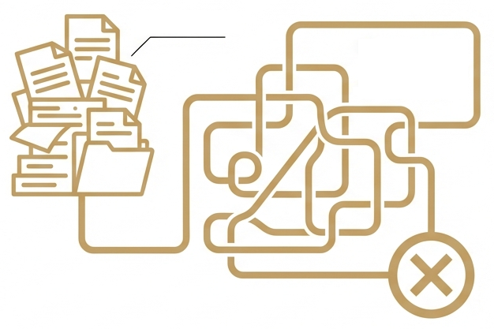
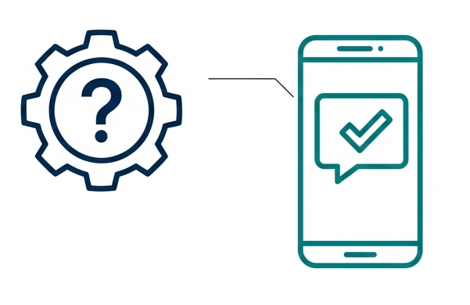



Inspiration: Unstructured Text to Proactive Governance
THE REALITY:
A Bureaucratic Maze
THE VISION:
A Public Service Recommender
PDF Laws
Manual interpretation
Proactive Delivery
No repetitive data submission
Administrative friction
Result: Missed benefits
How?
Core Question: How do we transform legislative rules into machine-readable execution logic?

Slide 3






Research Goals & Design Constraints
Explainability
Complexity
Interoperability
LLMs hallucinate and are non-deterministic.
In law we need traceable, auditable decisions.
Formal languages require exact syntax. Legal rules often use convoluted logic.
Faithful interpretation of legal text is needed.
Isolated proprietary logic
Grounding in European standards
The Stance: Draft Only, Never Execute
The AI acts as the Architect (interpretation). The symbolic logic acts as the Judge (validation).

Slide 4

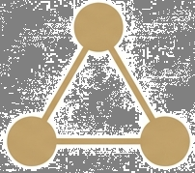

Background: The Building Blocks of Automated Governance
The Approach
The Data
The Rules
Neuro-Symbolic
Artificial Intelligence
RDF
(Resource Description Framework)
SHACL
(Shapes Constraint Language)
A hybrid architecture that combines :
Neural Networks (LLMs) for interpretation,
Symbolic Logic (Knowledge Graphs) for execution.
The standard for validating the structure and content of RDF graphs.
Supports embedded SPARQL.
A graph-based representation of facts using triples:
(Subject – Predicate – Object)

Slide 5
Methodology: A Neuro-Symbolic Extraction – Generation Pipeline
1. Input:
Public Service
PDF Document
Why intermediate representations?
To guide the LLM reasoning process by anchoring it to a structured reference.
2. Summarization:
LLM extracts preconditions
Why Pydantic?
To enforce structure before logic is generated.
Pydantic schema
3. Information Model:
Intermediate JSON representation
Why EU vocabularies?
For interoperable, cross-border logic.
4. Graph Construction:
RDF Turtle + HTML visualization.
Uses CCCEV, CPSV-AP vocabularies.
5. SHACL Shapes Generation:
Core SHACL for simple checks.
Embedded SPARQL for complex rules.
Why SPARQL? Because rules usually depend on graph topology and joins, not flat attributes.
Service Graph
Citizen-Service Graph
SHACL-spec JSON
SHACL Shapes Graph

Slide 6
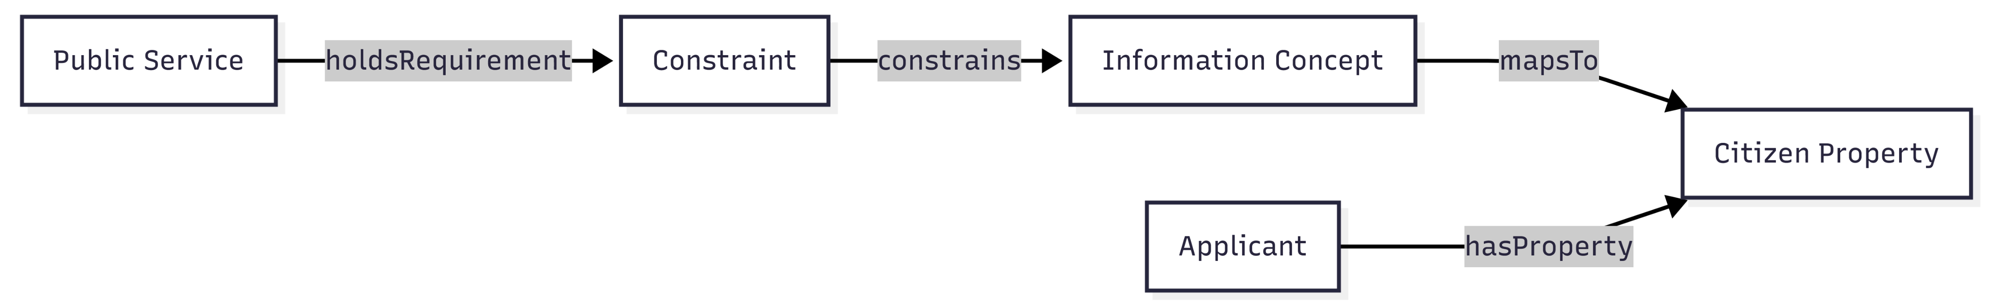
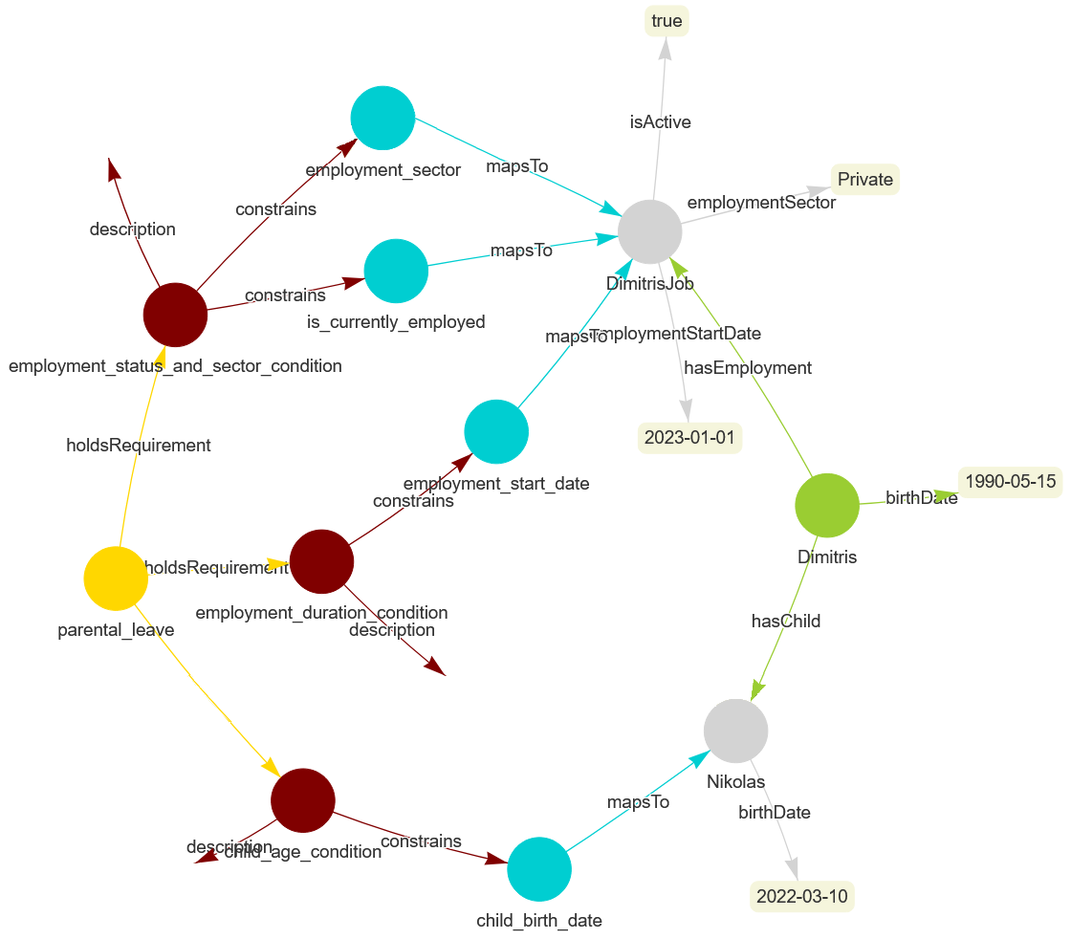
Text → Knowledge Graph → Executable Logic
Currently in Public or Private sector.
Public Service: Root node representing a service.
Constraint: A single eligibility precondition.
Information Concept: Abstract information needed to evaluate a constraint.
Citizen Property: A collection of concrete data facts attached to a citizen instance.
Applicant: Target node of the SHACL validation engine.
Citizen Data
(Citizen Graph)
Eligibility rules
(Service Graph)
One year with the same employer.
1 Rule
1 Constraint
1 SHACL Shape
Child less than 8 years old.
Natural Language
Symbolic Anchor
Executable Logic
The graph creates an audit trail. We trace exactly which data point was used to evaluate which precondition.

Slide 7



Validation via The Mutation Testing Framework
The Golden Citizen
Mutation Scenario
Validation Verdict
Mutation Injection
Validation Engine
Marginally eligible
(Income: € 11.999)
- description: “High income."
- ex:Income :amount 12000.0 .
- expected_violation_count: 1
Pass
Conforms to Rules
Fail
Violates Rules
Save Log
Why Mutation Testing?
The intuition: Treat the generated logic like software code that must be stress-tested:
to detect “silent failures” in the eligibility logic.
to mimic the real-world edge cases.
How does Validation happen?
Citizen Graph
+
SHACL Shapes
Binary Decision
+
Validation Report
CSV
Each run is defined by a configuration tuple: ⟨ Document, Model, Prompting Strategy ⟩

Slide 8
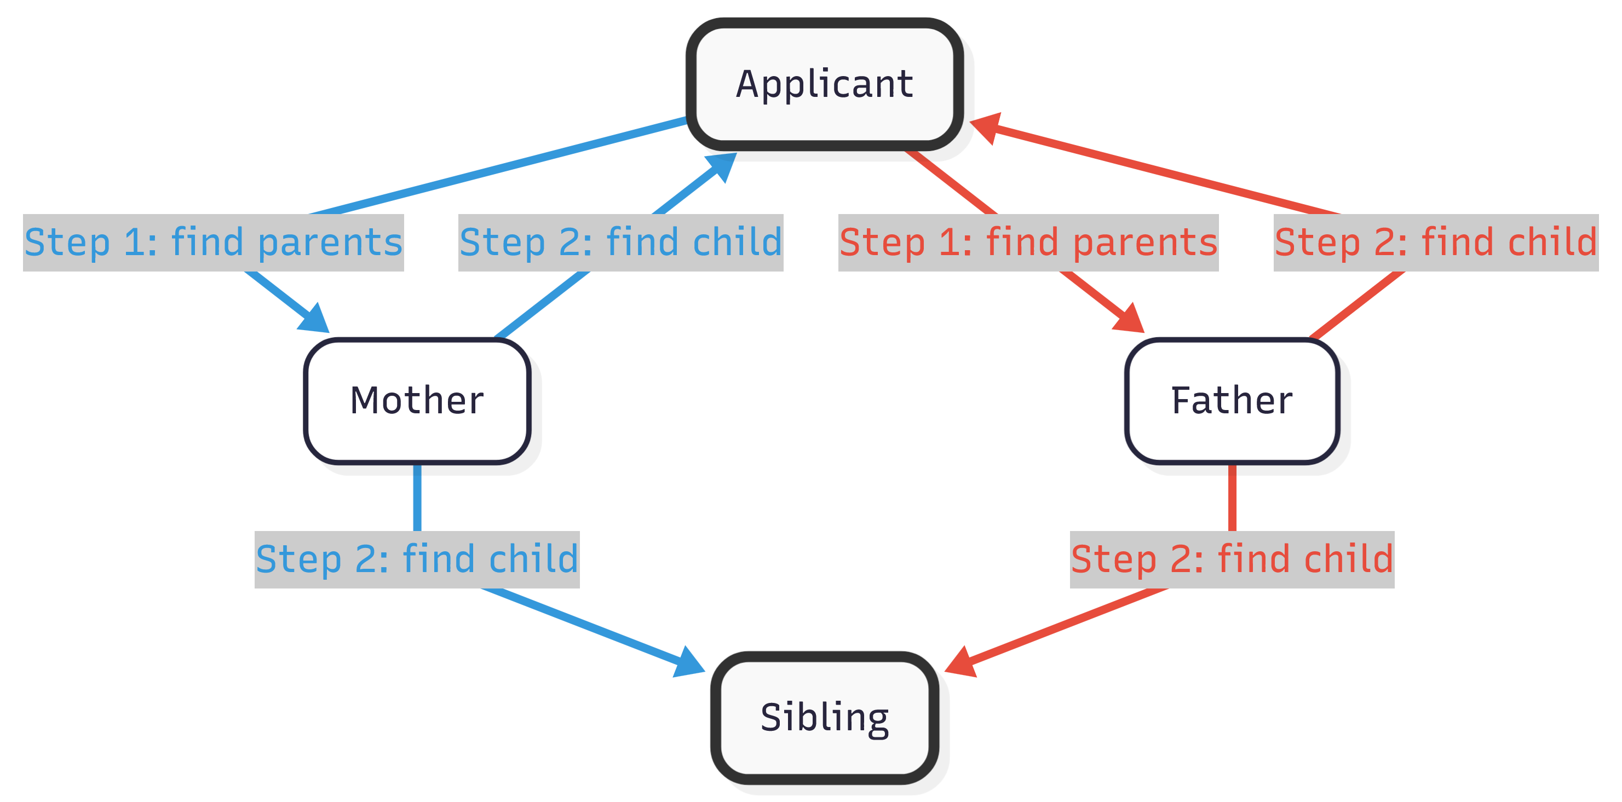
Results I: Cognitive Dissonance in Code Generation
Case study: Gemini 2.5 Pro with Few-Shot Prompts on the Student Housing Allowance document.
The Illusion of Fluency
The Double Counting Trap
The “Illusion of Fluency” Gap
Counted every child twice (once per parent path)
Failure to understand graph topology
High syntactic proficiency
Low logical understanding
Models seemed to memorize RDF grammar but failed to grasp the mathematical logic of the preconditions.

Slide 9


Results II: The “Smart Model” Abstraction Trap
Case study: A precondition that proved problematic on the Parental Leave document.
The Precondition:
The beneficiary must be employed, either under a dependent employment relationship or a salaried mandate, in the private or public sector.
Gemini 2.5 Flash (Smaller “Low Latency” Model) | Gemini 2.5 Pro (Larger “Reasoning” Model)
Copied the rule literally. | Summarized the concept of the rule.
Sector = Private OR Public | Employed = True
CORRECT | FAILED
Maintained the precise legal boundary. | Lost the legal boundary. (e.g., erroneously included freelancers)
Intelligence ≠ Fidelity. The larger model over-simplified during interpretation, causing semantic drift.

Slide 10
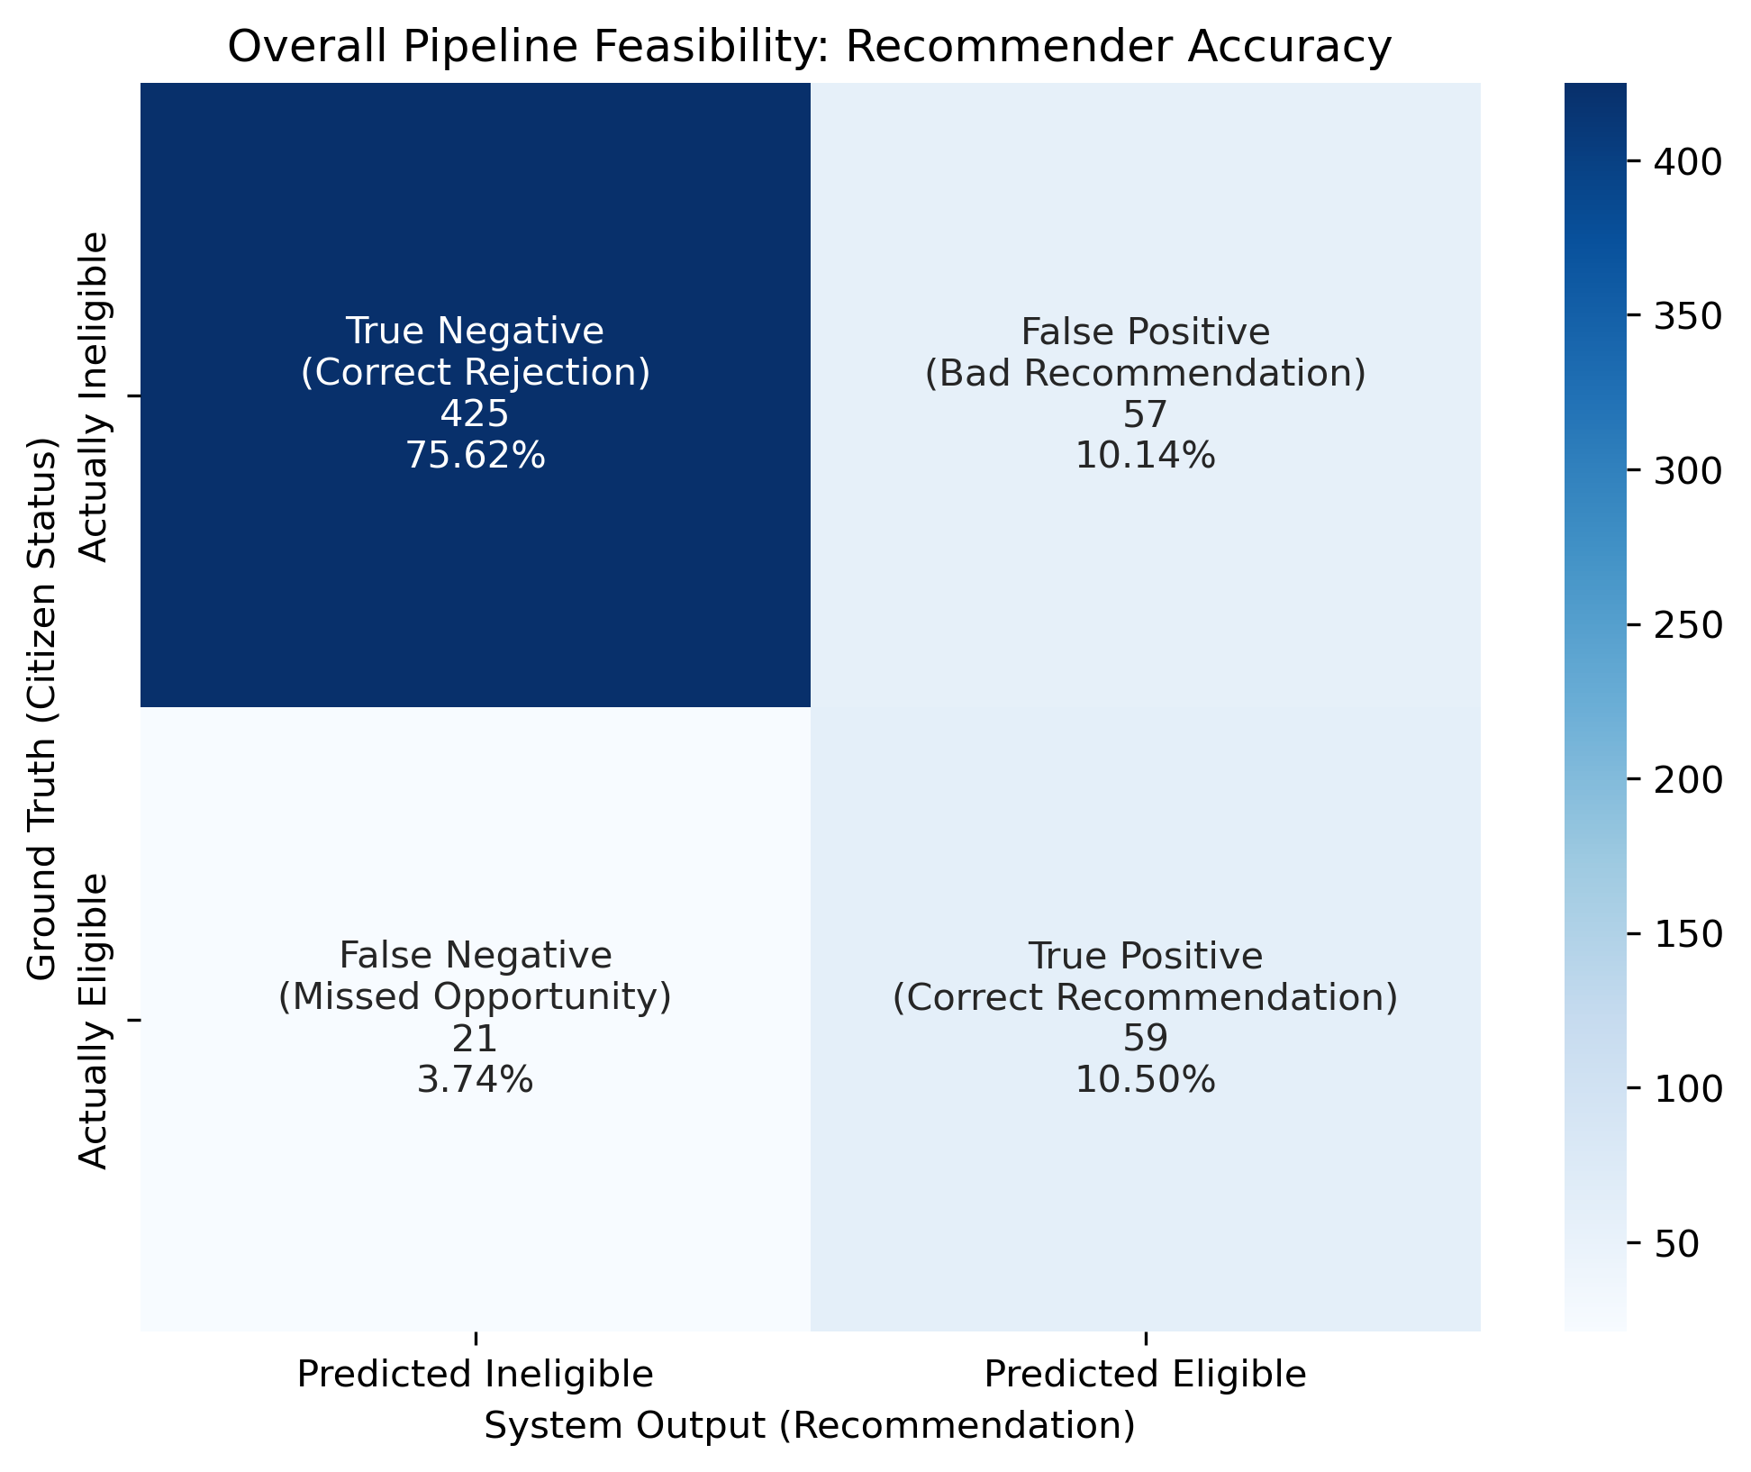
Risk Asymmetry in Public Service Recommendation
The “Dangerous” Quadrant
Why does this matter?
Movie recommender:
A bad suggestion is a simple nuisance.
Public Service recommender:
A False Positive is a broken promise. It sends a citizen to apply for a benefit they will be rejected for.
Conclusion: We must prioritize Precision over Recall.

Slide 11



Conclusions & Future Work
Final Verdict
A Roadmap to the Future
Feasible?
Step 1: Methodological Refinement
Step 3: Digital Sovereignty
Local, open weights models
Step 2: Scalability & Interoperability
Full adoption of EU core vocabularies
Human-expert root cause analysis
Mutation testing based self-correction
Government infrastructure
Expand to heterogenous domains
Yes, for simple to intermediate bureaucracy.
Performance collapses for higher complexity.
Reliable?
Not entirely, but intermediate data structures and neuro-symbolic separation proved essential.
Deployable?
Not yet, but this work has explored the prerequisites for the path forward.

Slide 12

Thank you

